Slide 1
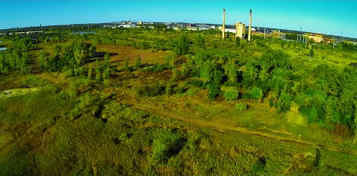
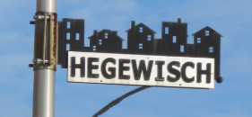
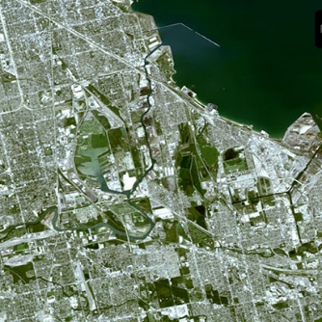
Southeast Environmental Task Force Workshop
August 9, 2018

Slide 2
Demographics Within One Mile Radius of Both Sites
Demographic Estimates | Lincoln Park Site | Calumet Site
Population | 52,020 | 8,413
Households | 22,297 | 2,690
Male | 50.2% | 48.5%
Female | 49.8% | 51.5%
Hispanic/Latino | 10.5% | 67.2%
Black or African-American | 6.1% | 6.3%
White, Non-Hispanic | 75.0% | 26.3%
Younger than 18 | 15.2% | 26.8%
Older than 65 | 7.0% | 12.7%
Female-Headed Households (with 18-under present) | 5.1% | 30.1%
Weighted Per Capita Income | $69,461 | $20,430
Sources: U.S. Census Bureau, American Community Survey, Five-Year Estimates, 2012-2016; ESRI ArcGIS 10.5.1

Slide 3
Demographics Continued
In comparison to the Lincoln Park Site, the proposed site has a surrounding population that is: - Predominantly Latino
More young children under 18 (~2,200)
More residents older than age-65 (~1,000)
More female-headed households with children present (~800 Households)
More than 8,000 total people.

Slide 4
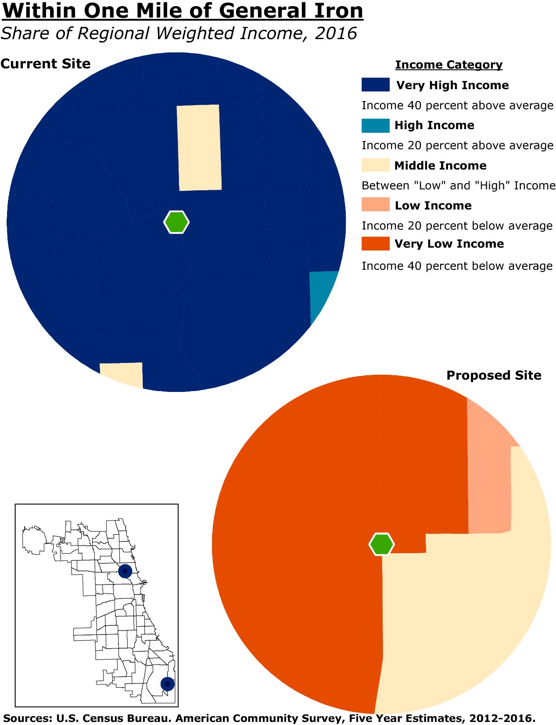
Comparing Current Site to Proposed Site: 2016 Income

Slide 5
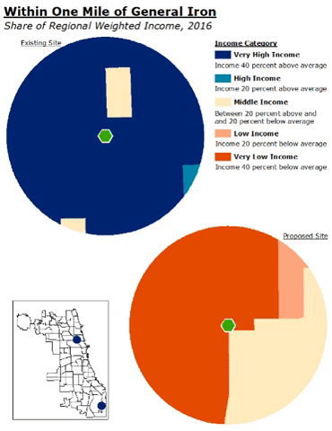
Change in income near proposed site

Slide 6
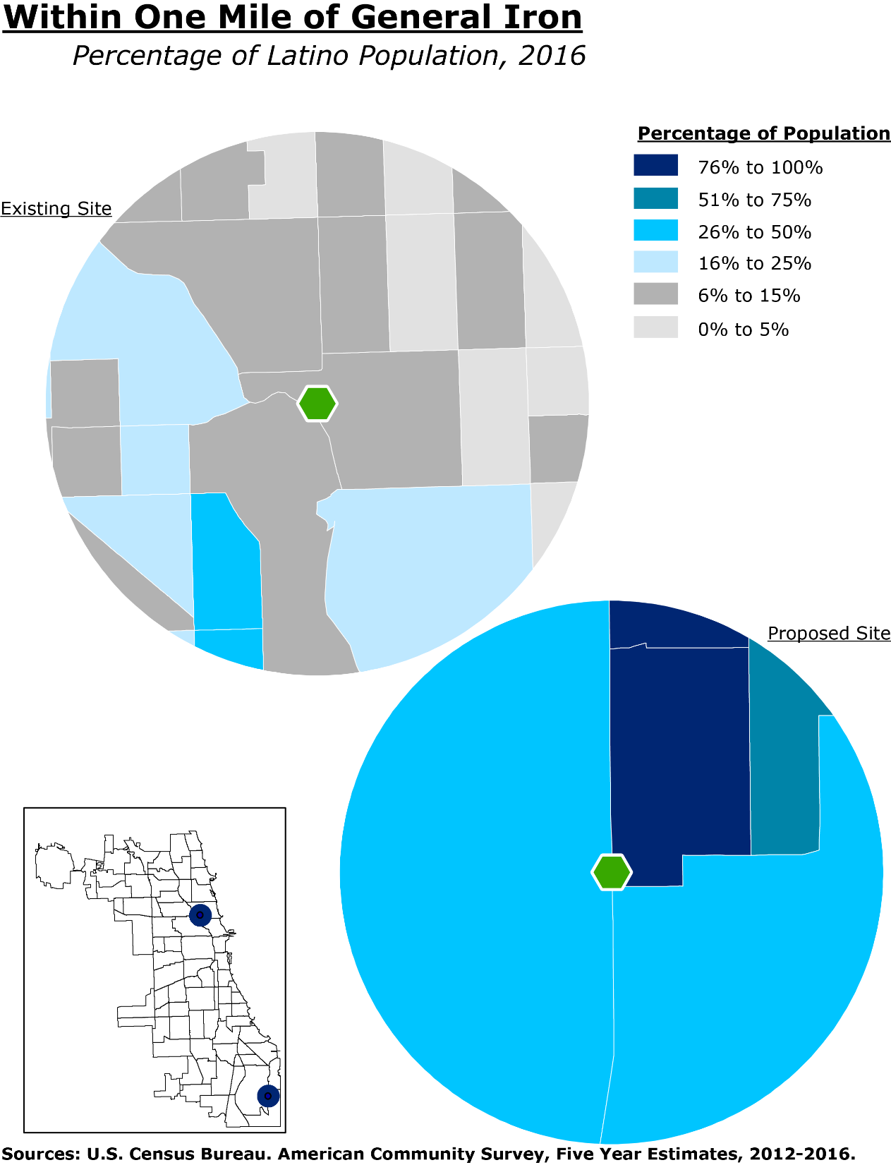
Proposed Site: Latino Population

Slide 7
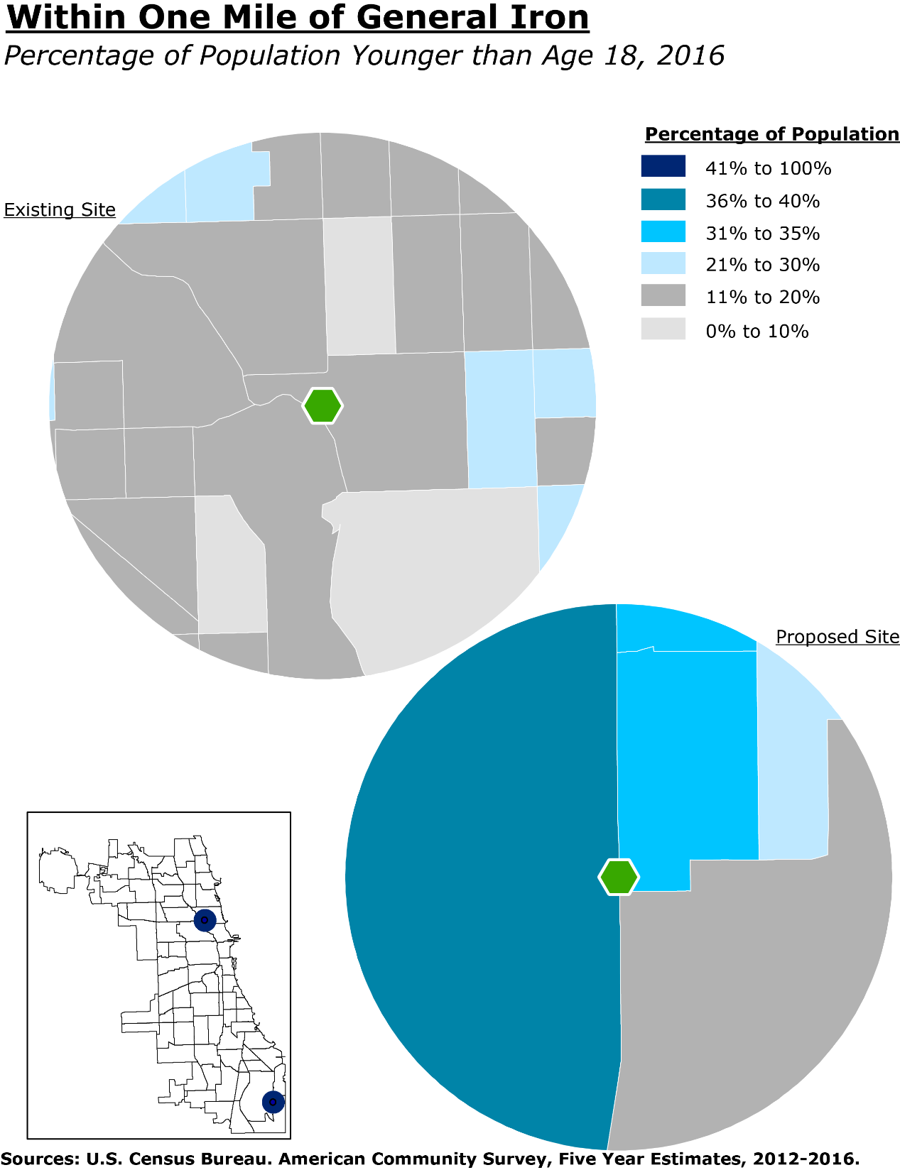
Proposed Site: Youth Population

Slide 8
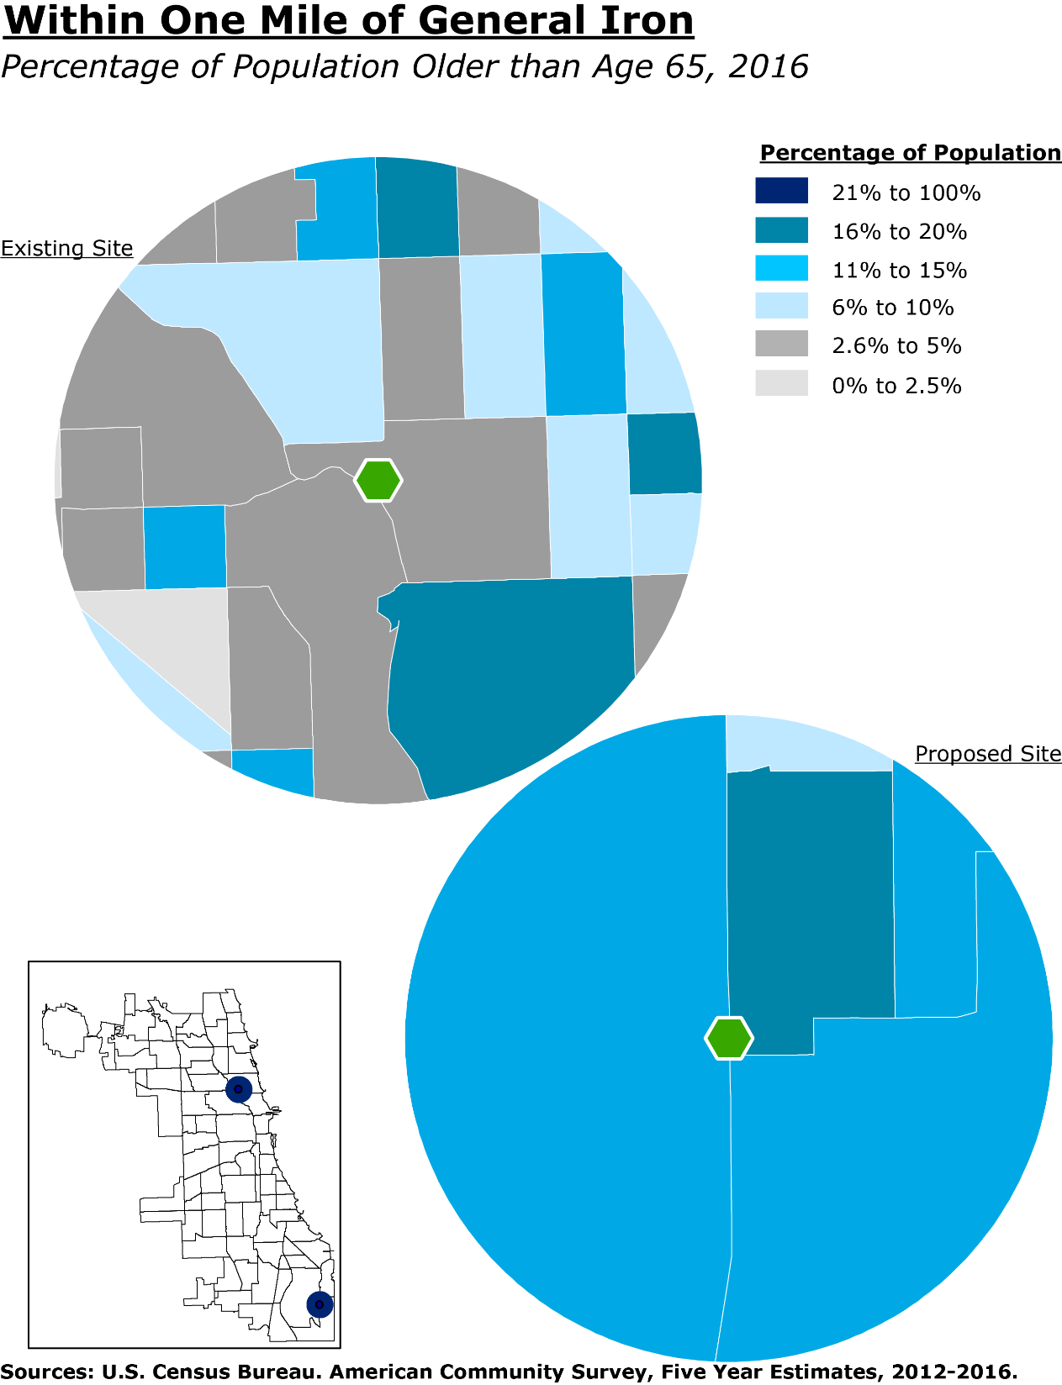
Proposed Site: Elderly
Population

Slide 9
Tax Increment Financing (TIF)
TIF is an economic development tool that municipalities can implement.
TIF seeks to capture future property tax increases to finance development.
The program is typically used to issue bonds (debt), along with spending.
Spending is traditionally meant for discretionary infrastructure or public-private partnership development deals based on a plan.

Slide 10
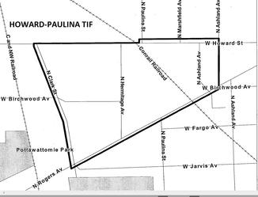
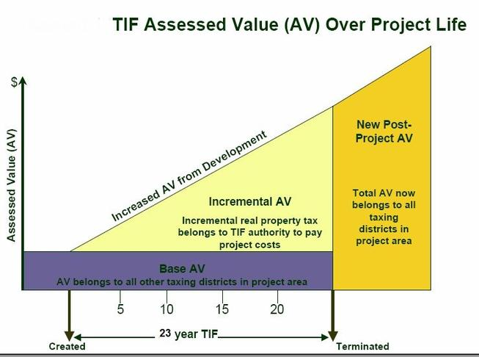
Tax Increment Financing (TIF)
When a TIF district is created the value of ALL the properties inside the district is assessed and the total amount of property tax generated by all those properties is baselined.
Life-span of TIF district is 23 years.
For the next 23 years all property revenue ABOVE the base amount is captured by the TIF district. This amount – the amount over the base —is called the incremental revenue.

Slide 11
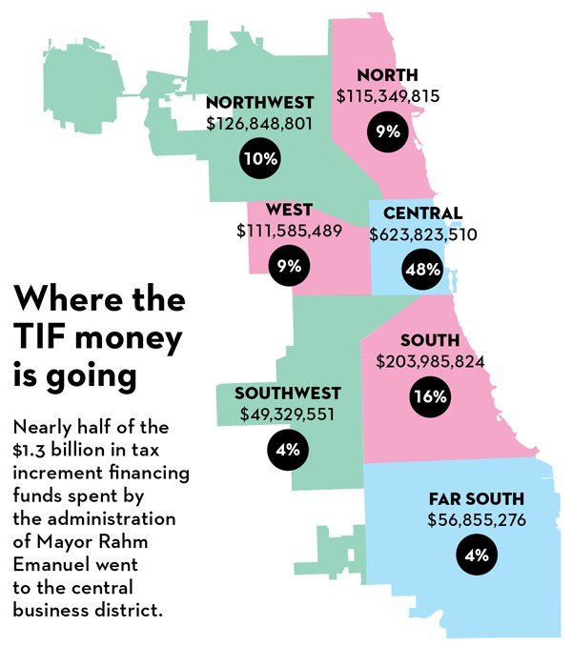
Tax
Increment
Financing (TIF)
“Who wins and loses in Rahm's TIF game?” (2015)
- Ben Joravsky, Chicago Reader

Slide 12
What is Zoning?
Zoning is the set of government regulations that control how land is used.
Zoning separates land uses into categories (residential, commercial, industrial, etc.)
Zoning regulations are adopted by local governments.

Slide 13
Types of Zoning
Zoning Ordinance: The Standard Rules
Special Zoning
In Chicago most zoning regulations involve a multitude of exceptions and special cases.

Slide 14
Who’s Who in Zoning
Alderman
Zoning Board of Appeals (appointed by Mayor)
Plan Commission (appointed by Mayor)
City Staff (employed by Mayor)

Slide 15
Common Special Cases
Special Uses, Exceptions and Variances
Zoning Map Amendments
Planned Manufacturing Districts
Industrial Corridors

Slide 16
Planned Manufacturing Districts
15 in Chicago
Created by City Council by direct ordinance
Zoning for entire district, not for specific parcels
Some but not all have buffer zones
Goose Island is first PMD to be partially dismantled

Slide 18
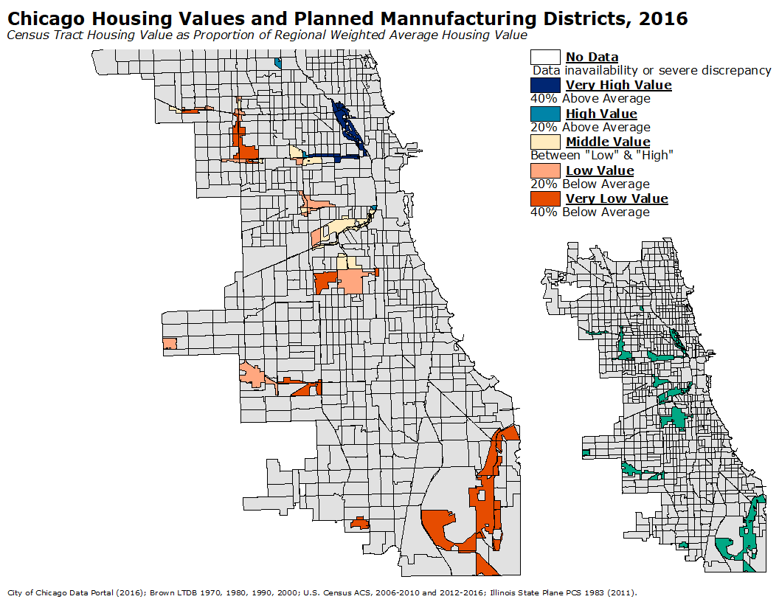

Slide 19
Good and Bad of PMDs
Good
Bad
Certainty
Ease of industry to move in
Not controlled by Aldermen
Same as good plus
Most special zoning does not apply in PMDs
No agriculture and limited open space options in PMDs
May attract uses that cannot go elsewhere.

Slide 20
Industrial Corridors
About 25 in Chicago
These are planning areas not zoning districts
More flexible than PMDs
May include non-industrial zoning as well as manufacturing

Slide 21
Good and Bad of Industrial Corridors
Good
Bad
Flexible
Can create clusters of industry
Flexibility for city
Uncertainty

Slide 22
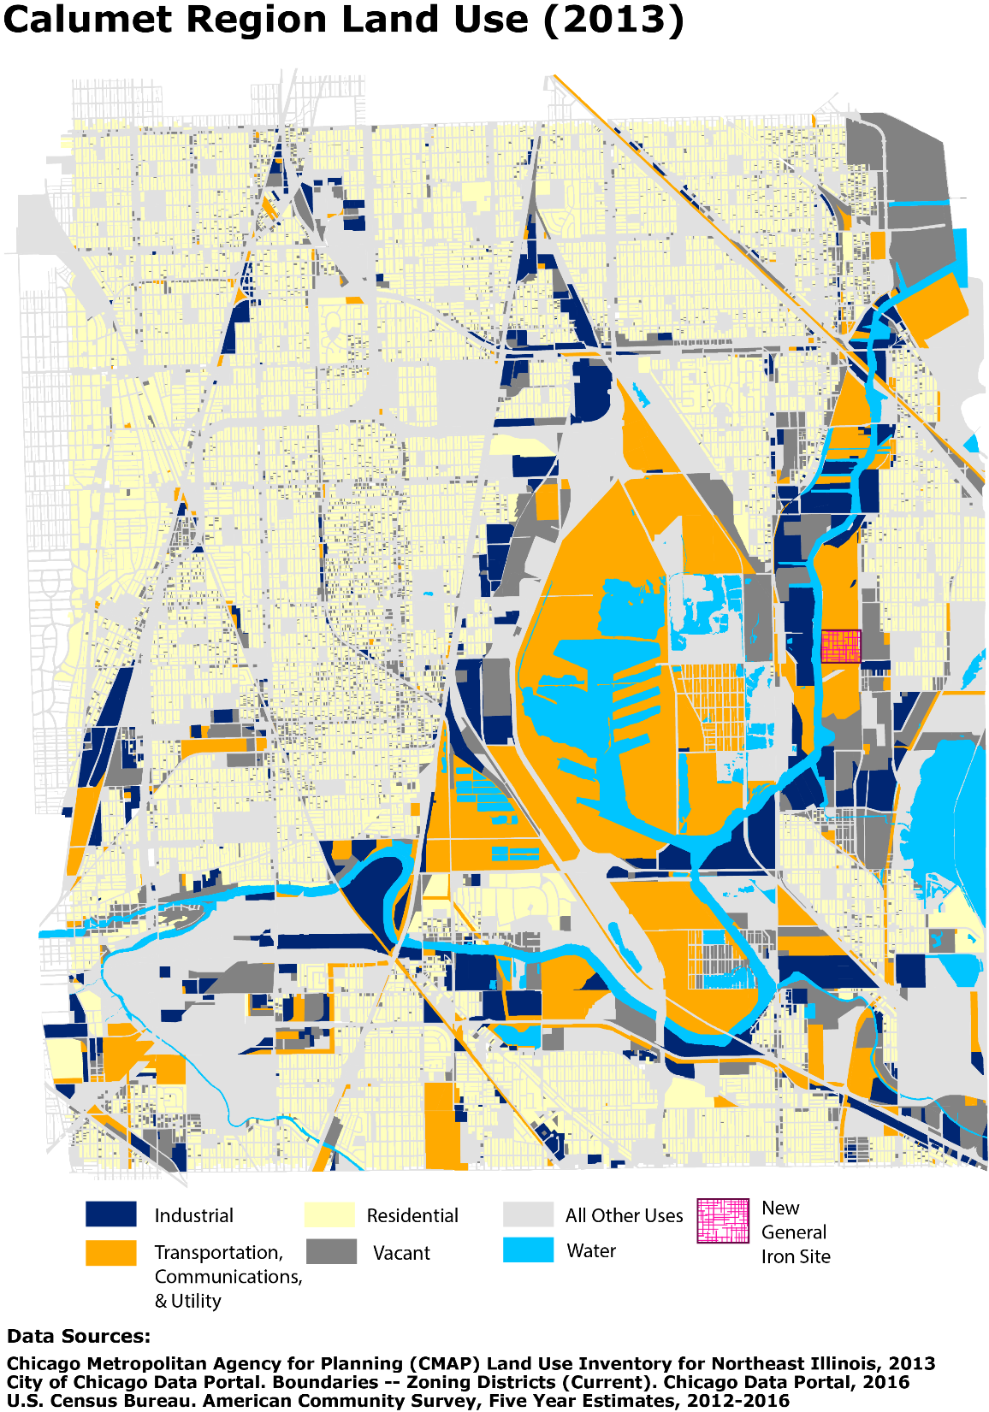
Calumet Region Land Use 2013

Slide 23
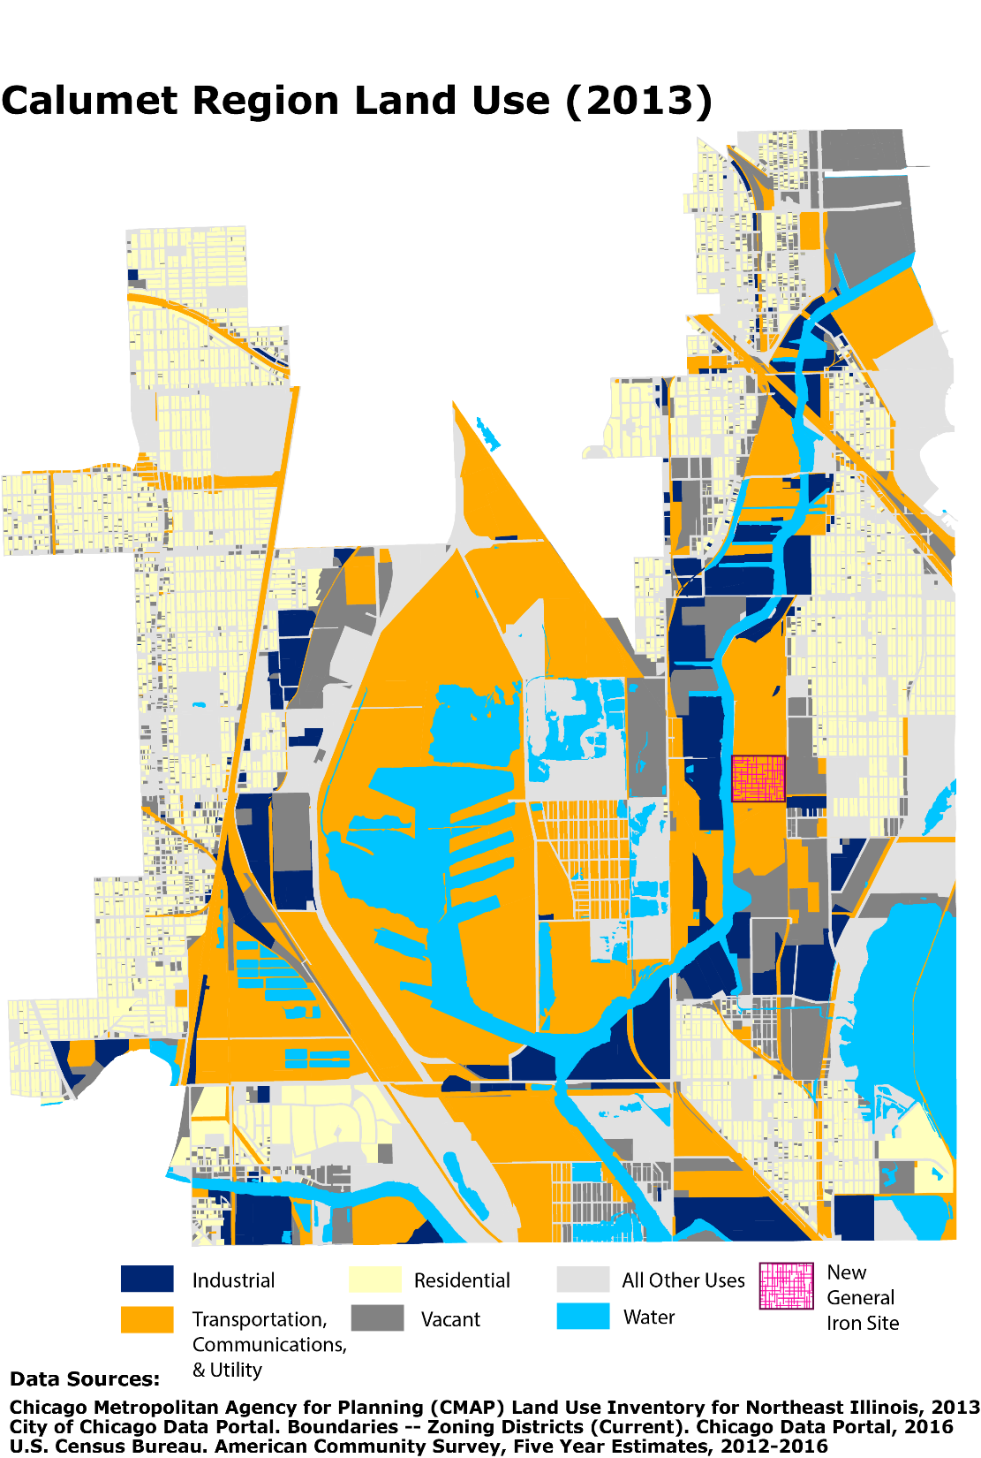

Slide 24
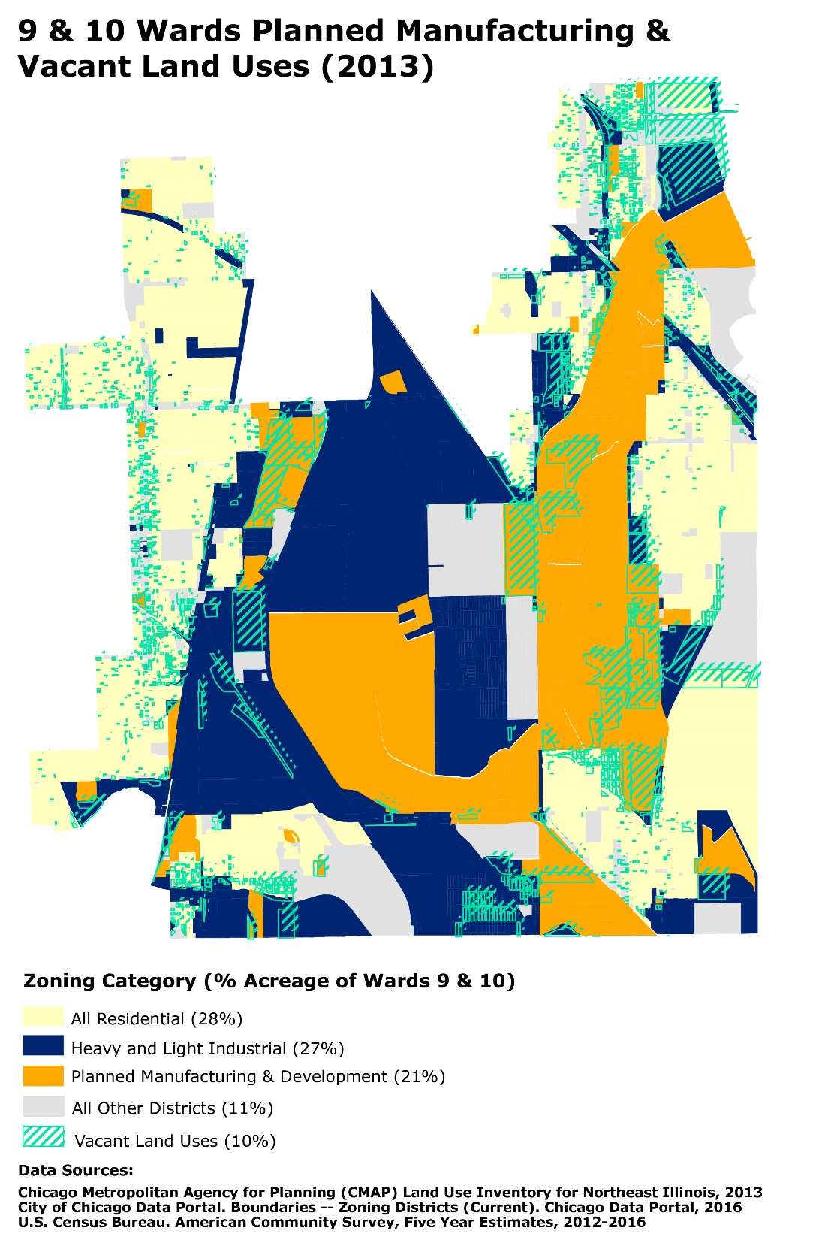

Slide 25
Historical Land Use in Lake Calumet

Slide 26
Land Use & Zoning Summary
Nearly 15% of Planned Manufacturing District (PMD) land is vacant.
Nearly 42% of all Wards 9 & 10 Vacant Land is in the PMD.
PMD permitted manufacturing uses match the heaviest manufacturing district.

Slide 27
Land Use & Zoning Summary
PMDs have different Planned Development requirements than Manufacturing Districts.
The Lake Calumet PMD is the only PMD with permitted Hazardous Materials Disposal or Storage.
PMD Use Table & Standards, 17-6-0403-F

Slide 28
City’s Hazardous Waste Definition:
“Hazardous waste” means a waste, or combination of wastes, which because of its quantity, concentration, or physical, chemical or infectious characteristics may cause, or significantly contribute to an increase in mortality or an increase in serious, irreversible, or incapacitating reversible illness, or pose a substantial present or potential hazard to human health or the environment when improperly treated, stored, transported or disposed of or otherwise managed, or which has been identified by characteristics or listing as hazardous pursuant to Section 3001 of the Resource Conservation and Recovery Act of 1976, P. L. 94-580 as amended, or pursuant to regulations promulgated by the Illinois Pollution Control Board."

Slide 29
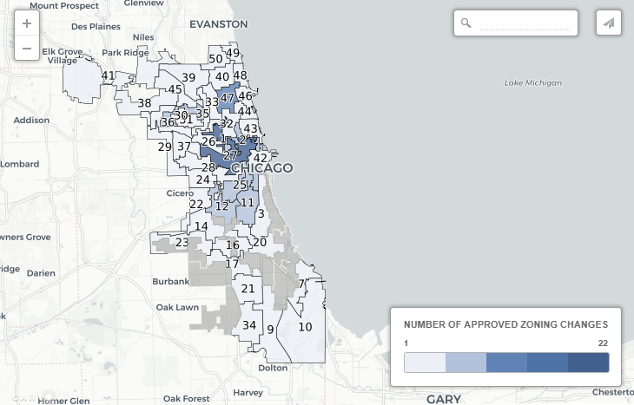
Zoning Changes in Chicago (2017)
Steve Vance Analysis

Slide 30
Big and Bold Ideas:
Eliminate the Lake Calumet PMD
Demand buffer zones around PMD and industrial corridor
Ban hazardous wastes in PMD
Downzone vacant land in the area

Slide 31
Community Intervention Tactics:
Law
Public Health
Zoning Changes
Community Organizing

Slide 32
Community Intervention: Zoning Change
Show up en masse to City Council hearing(s)
Sometimes City Council will decide to postpone their vote, hoping that the people will forget to come to the next meeting and they can vote then with less public scrutiny.
Even if the proposal is voted down, watch for the developer or other proponent of the re-zoning to resurface. Be sure you keep names, addresses, phone numbers, or e-mail addresses you may have accumulated during the re-zoning opposition campaign.

