Slide 1
Community Activism: A Framework for Mapping Community Assets
Presented by:
William C. Kling, JD
Clinical Assistant Professor
University of Illinois at Chicago

Slide 2
The Narrative
Thinking In Terms of the “Justices”
Social Justice
Economic Justice
Criminal Justice
Environmental Justice
Food Justice
Health Justice

Slide 3
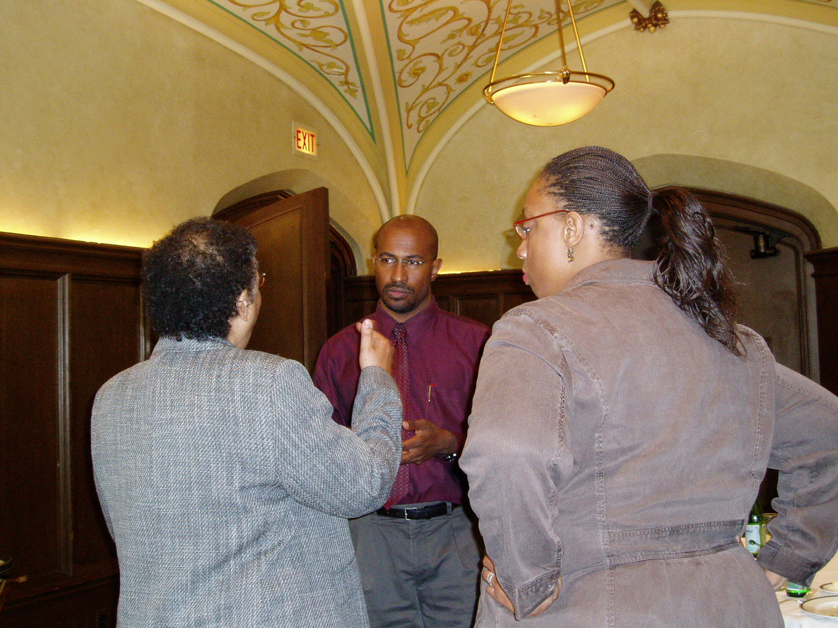
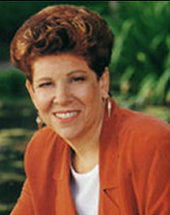
“We should concentrate on creating
organizational packets, resources
that continue to expand in potential
until needed.”
--Margaret Wheatley

Slide 6
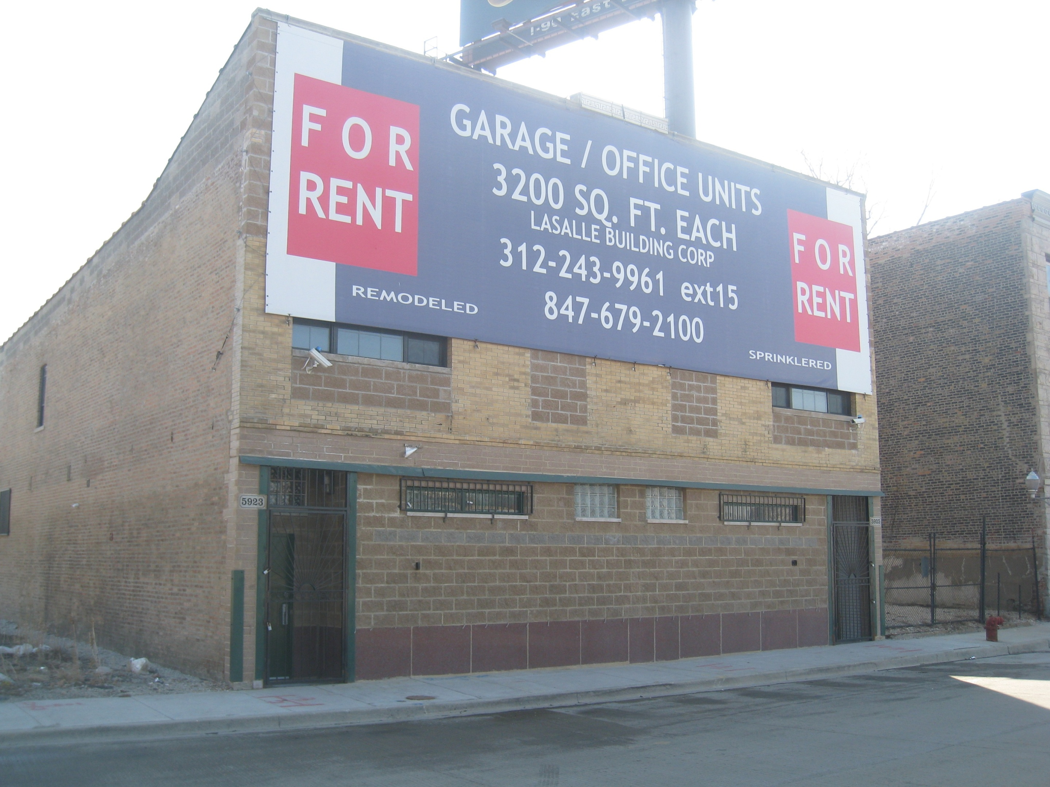

Slide 7
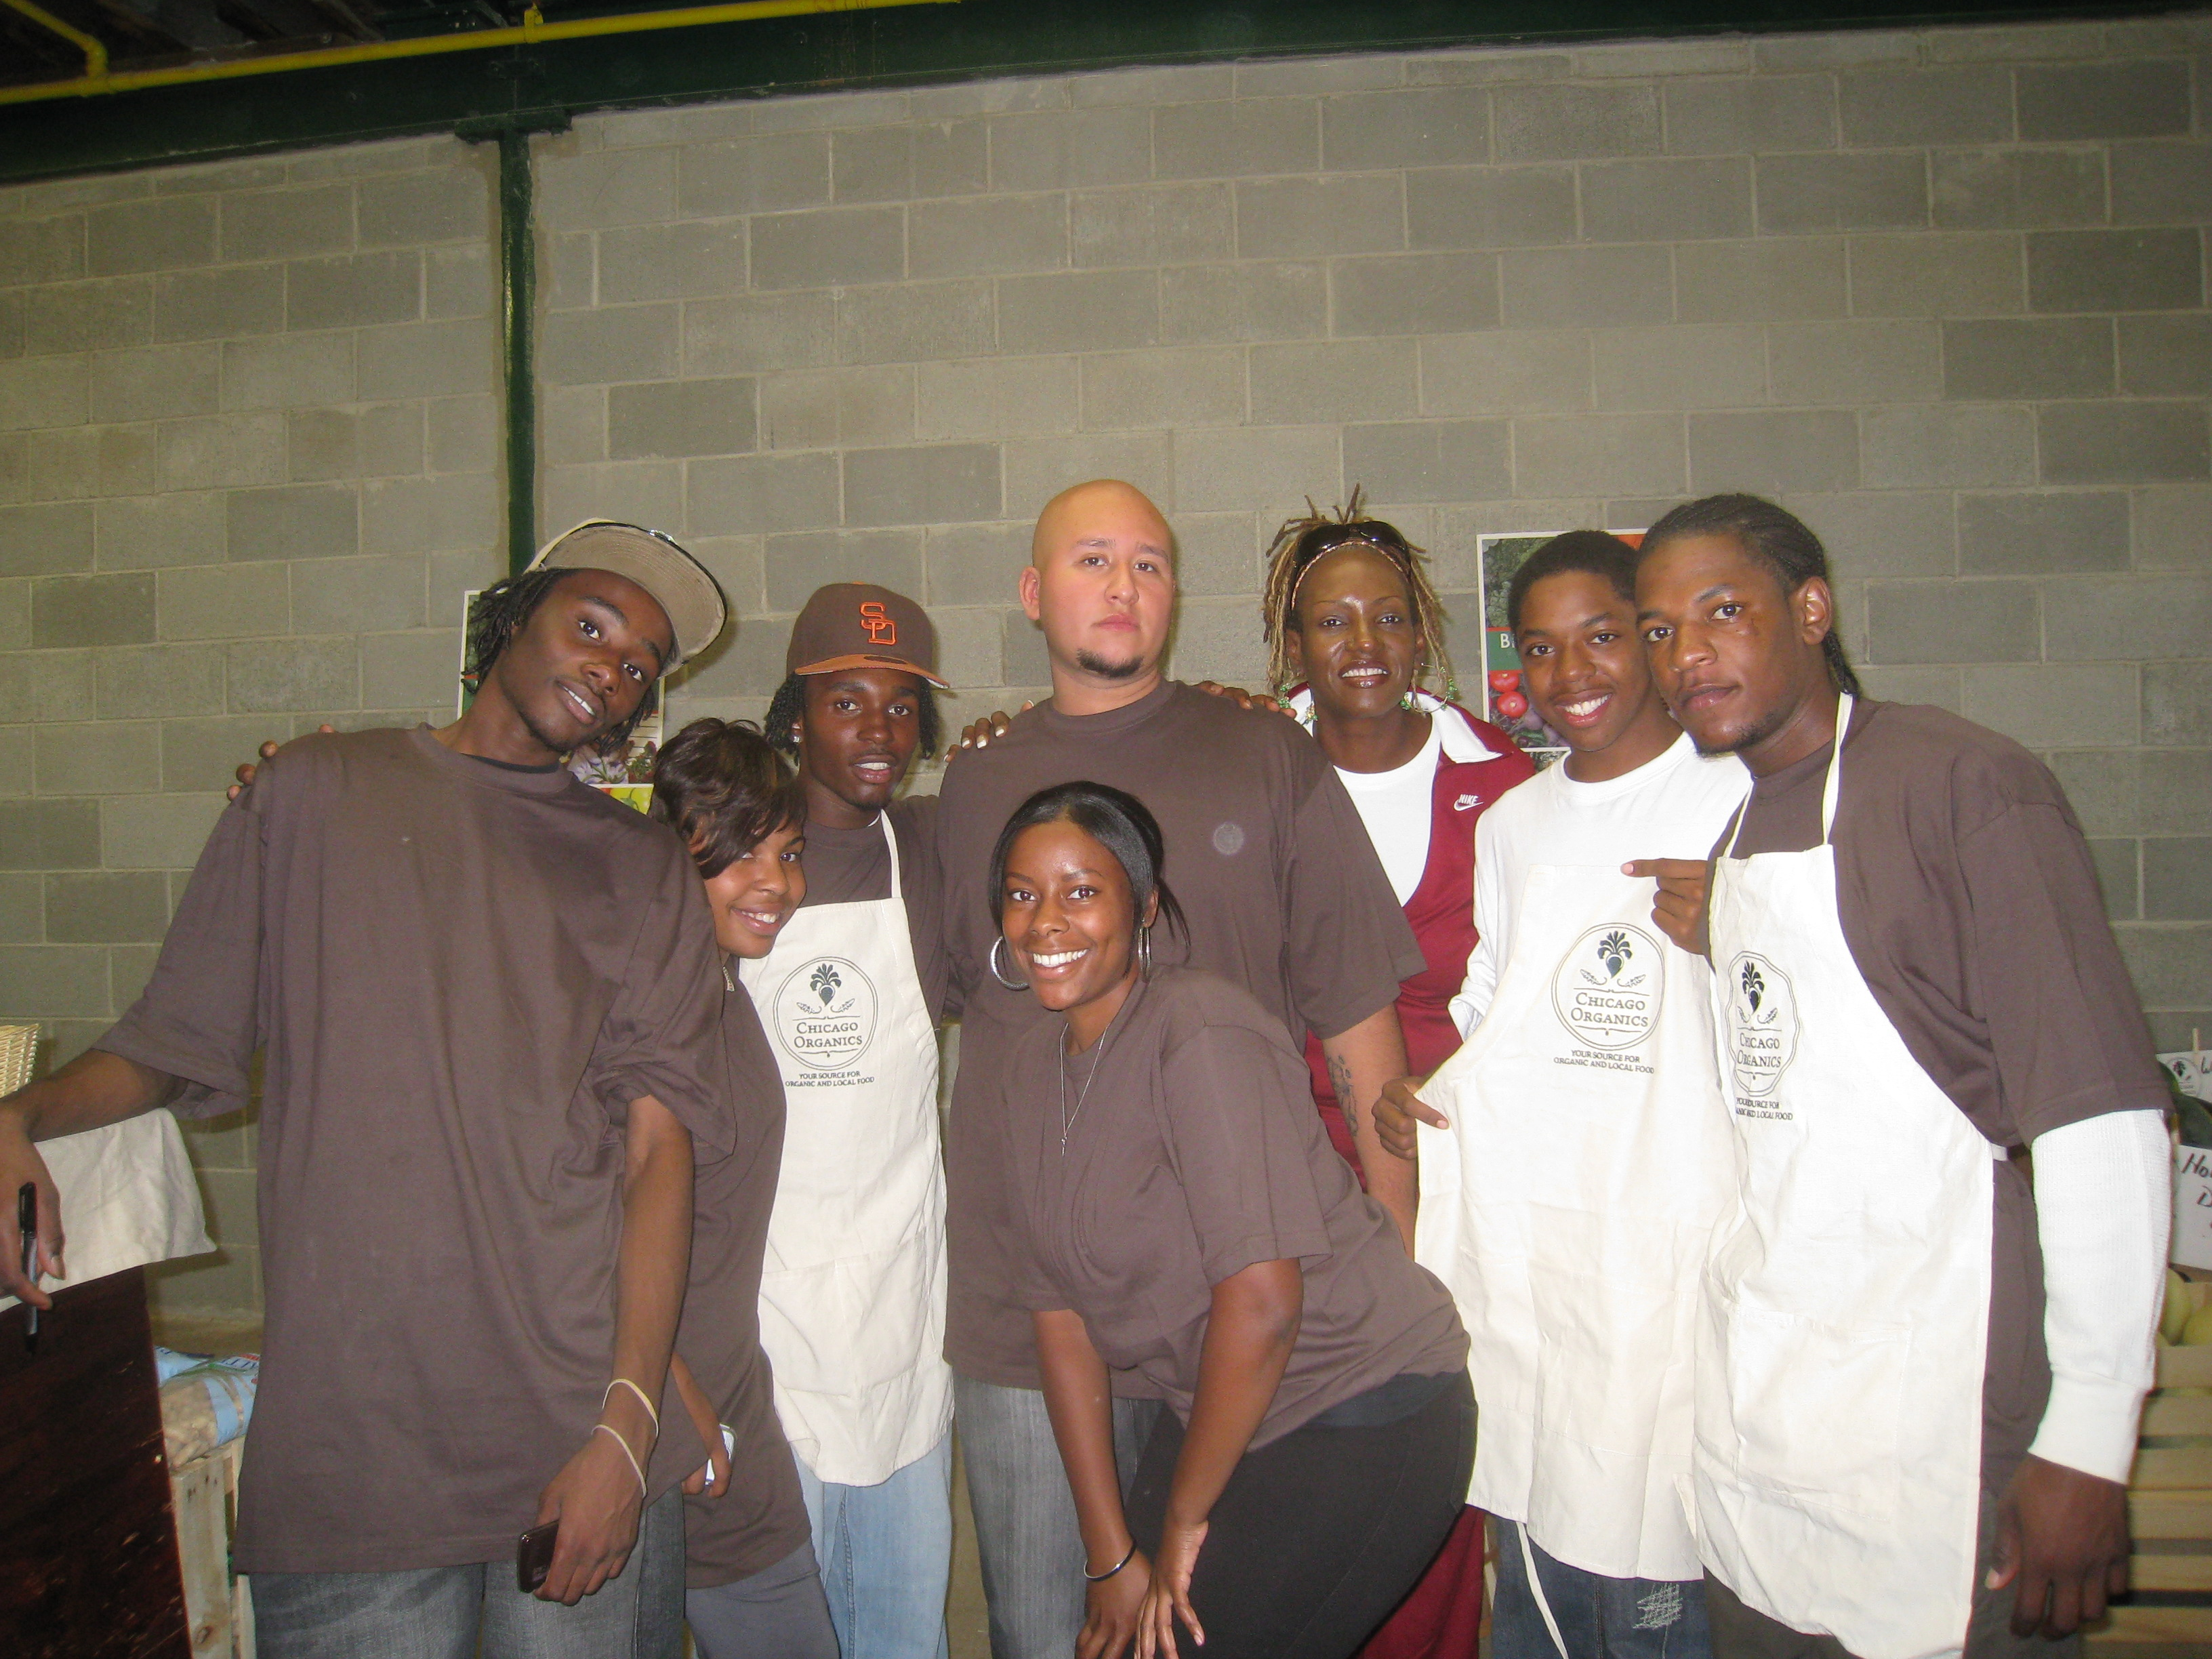

Slide 8
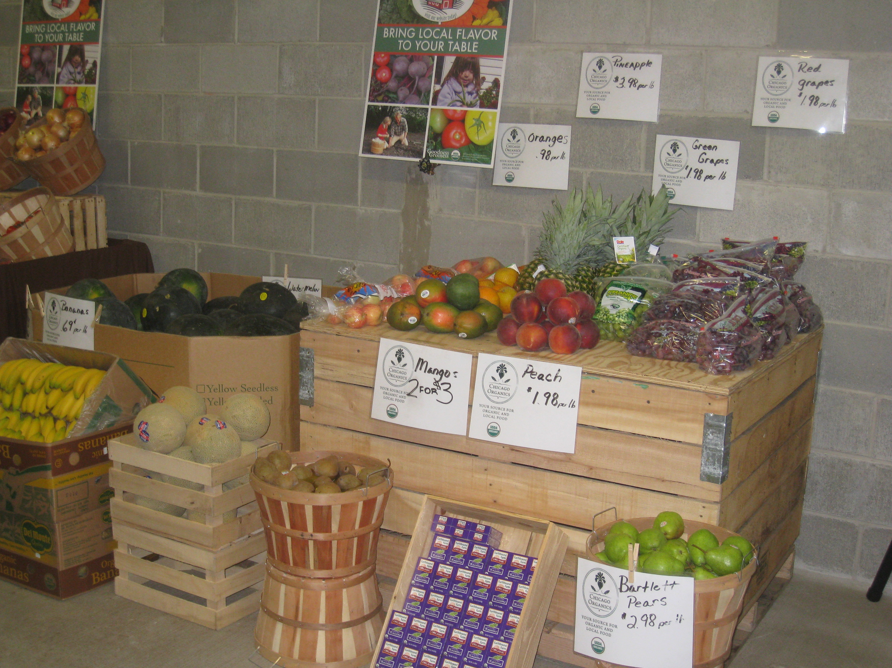

Slide 9
www.youtube.com/watch?v=ydZfSuz-Hu8

Slide 10
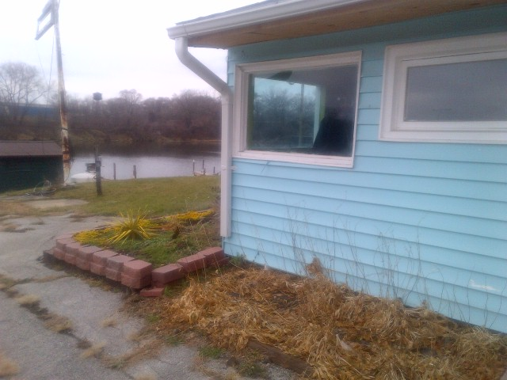

Slide 11
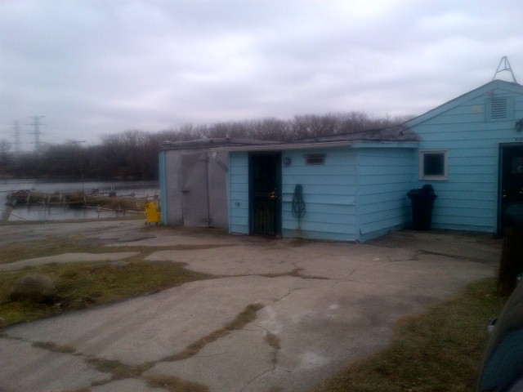

Slide 12
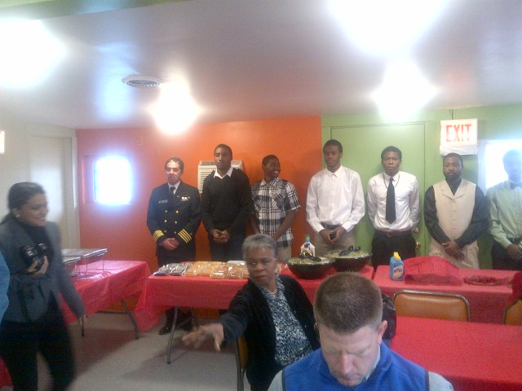

Slide 13
THE CONTEXT
Cultural “Competence”
Cultural “Relevance”
Historical Trauma

Slide 14
Cultural “Competence”
NASW Standards (2001)
Ethics and Values
Self Awareness
Cross Cultural Knowledge
Cross Cultural Skills
Service Delivery
Empowerment and Advocacy
Diverse Workforce
Professional Education
Language Diversity
Cross-Cultural Leadership

Slide 15
Cultural “Relevance”
African American Community (Example)
Survival
Recovery
Development
Self-determination.
“An Afrocentric Approach to Building Cultural Relevance in Social Work Research”, (Davis, Williams, Akenyila)

Slide 16
Historical Trauma
Individual Traumatic Exposures
child abuse
intimate partner violence
street violence
Group Traumatic Exposures
terrorist events
natural disasters
historical trauma

Slide 17
A FRAMEWORK FOR COMMUNITY ENGAGEMENT AND ADVOCACY

Slide 18
Navigating the Infrastructure
Collecting information
Studies/research
Internet
Environmental scan
Analyzing/Assimilating information
Putting the pieces together
Creating Action Plan
Delivering information
Formal vs. informal (venue)
Large and small groups
Written documents

Slide 19
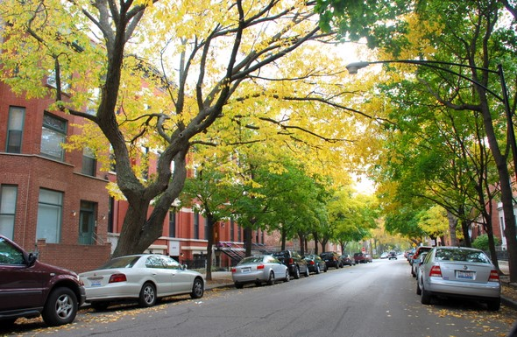
COMMUNITY

Slide 20
Mapping Assets and Liabilities
Determination of Community Assets and Liabilities
Political environment
Business environment
Community-based environment
Grass Roots environment

Slide 21
Political Infrastructure
Local
Municipal
FSS
CDPH
CPS
CPD
CPD
CHA

Slide 22
Political Infrastructure (con’t)
Regional (County)
State
Legislative branch
State senators and representatives
Leadership
Committees
Personal interests
Executive branch
Governor’s initiatives
Agencies

Slide 23
Political Infrastructure (con’t)
Federal
Legislative branch
Senators and representatives
Leadership
Committees
Personal Interests
Executive branch
President, etc.
Agencies
DC vs. Regional offices

Slide 24
Community-Based Infrastructure
Community-based organizations
Community-based
Health-based
Social service-based
Economic development-based
Education-based

Slide 25
Grass Roots Infrastructure
Local farm groups
Farmers market groups
Neighborhood groups
Environmental groups
Political activist groups

Slide 26
Business Infrastructure
Business groups
Chamber of Commerce
Associations
Large industry
Small businesses
“Vertical” business

Slide 27
RELATIONSHIPS

Slide 28
Conclusion
Timing
Develop and maintain relationships
Utilize and demonstrate leadership capacity– BE THERE
Short, mid and long term goal setting
Patience!

Slide 29
WORLD-VIEW

